Slide 1
DEEP RECURRENT RANDOM FIELD NETWORK FOR PROTEIN SECONDARY PREDICTION
Alexander Rosenberg Johansen
Soren Kaae Sonderby
Casper Kaae Sonderby
Ole Winther

Slide 2
Introduction:
Deep Learning has become the state of the art for predicting protein secondary structure.
Recent methods propose:
Convolutions (which work with sliding time windows) with variants of auto-regressive models.
Convolutions with a CRF (Conditional Random Field)
Using bi-directional RNN.
The actual model propose a combination between two approaches:
A bi-directional recurrent neural network (Bi-RNN)
A Conditional Random Field (CRF)
This new approach is called as biRNN-CRF.
This model could be seen as a improve from a previous model, a RNN with sequential predictions based on time step.

Slide 3
RNN (Recurrent Neural Network)
Is a class of artificial neural network where connections between nodes form a direct graph (edges with defined directions) along a temporal sequence.
This particularity allows it to exhibit temporal dynamic behavior.
Two broad classes of network could be included in this definition:
RNN with finite impulse (Grafo dirigido acíclico).
RNN with infinite impulse (Grafo dirigido cíclico).
FULLY RECURRENT:
Basic RNN are a network of nodes (neurons) organized in different layers.
Each node in connected with a given direction is just one way.
Each node has a time-varying real-valued activation.
Also, each connection has a values denominated as weight.
Three types of nodes: Inputs, Outputs and Hidden nodes.

Slide 4
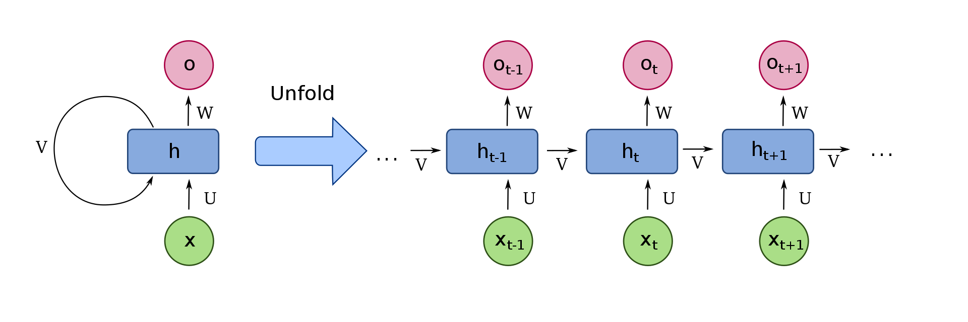
For supervised learning, real-valued input vector arrive at the input nodes (One vector at time).
Then, non input nodes (hidden nodes) compute its current activation as a nonlinear of the weighted sum of activations of all units that connect to it.
Finally, results from the last step are shown in output nodes.

Slide 5
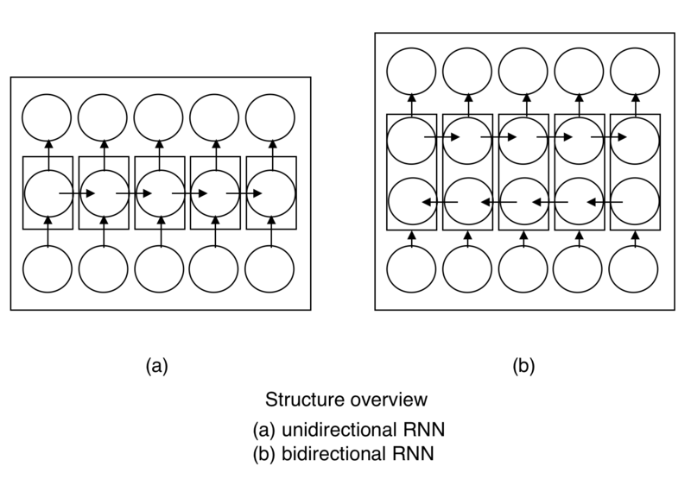
Bi RNN (Bidirectional Recurrent Neural Network)
Could be considered as an evolution from RNN.
Connect two hidden layer of opposite directions to the same output.
The output layer can get information from past (backward) and future (forward) simultaneously.
In traditional RNN future information cannot be reached. (It´s a limitation in its architecture.)
The principle of BiRNN is to split neurons of a regular RNN in two directions.
One for positive TIME direction (Forward) -> Future.
One for negative TIME direction (Backward) -> Past.

Slide 6
CRN: Conditional Random Field
Also known as Markiv Random Field.
It is a stochastic model used to label and segment data sequences.It’s a stocastic model to
Example:
With a sequence O1, … , On. This model assign a Si label for each element Oi.
While it seems to be very similar to the hidden Markov models (where the distribution of the probability of the labels is modeled together). In CRNs, the probability of the correct sequence of labels is modeled.
Furthermore, it can be represented as a non-directed graph where each vertex represents a random variable whose probability distribution should be deduced.

Slide 7
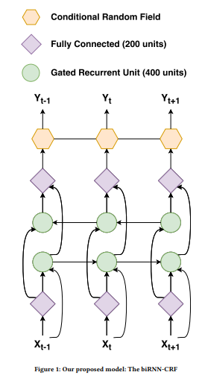
BiRNN-CRF

Slide 8
Architecture:
The architecture of the network is defined by three different types of learnable layers and one regularization layer.
The recurrent layer with gated recurrent unit (GRU).
A conditional random field (CRF).
A Bernoulli dropout regularization layer.
A fully connect layer (Regularization layer).

Slide 9
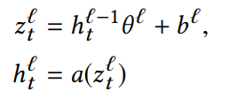

Fully Connected
Also known as a dense layer or a multilayer perceptron.
Where:
$h^{l}$ is the current layer.
${\text{Ө}}^{l}$ is the weight.
$b^{l}$ is the bias
$z^{l}$ represent the linear combination of the input.
t represents the time.

Slide 10
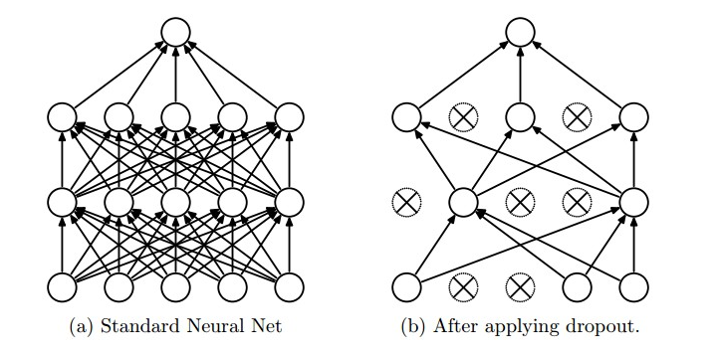
Bernoulli Dropout Layer
Dropout is very simple and yet very effective way to regularize networks by reducing coadaptation between the neurons.
Dropout works by randomly and temporarily deleting neurons in the hidden layer during the training with probability p.
Since a neuron cannot rely on the presence of other neurons, it is forced to learn features that are not dependent on the presence of other neurons. Thus network learns robust features, and are less susceptible to noise.
The purpose of the Bernoulli Dropout is to introduce noise such that the model becomes less dependent on combinations of specific activations.

Slide 11
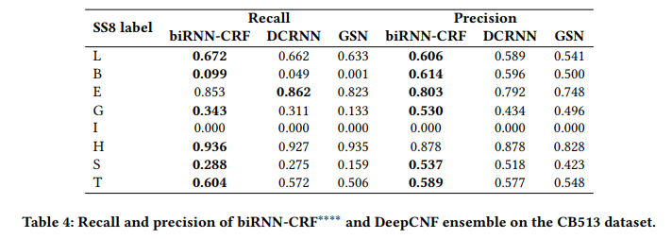
Some results

